Slide 1
Better life region Website update
11 June 2022
Notes:
Notes Notes Notes Notes Notes Notes Notes Notes Notes Notes
Notes Notes Notes Notes Notes Notes Notes Notes Notes Notes
Notes Notes Notes Notes Notes Notes Notes Notes Notes Notes
Notes Notes Notes Notes Notes Notes Notes Notes Notes Notes
Notes Notes Notes Notes Notes Notes Notes Notes Notes Notes
Notes Notes Notes Notes Notes Notes Notes Notes Notes Notes

Slide 2
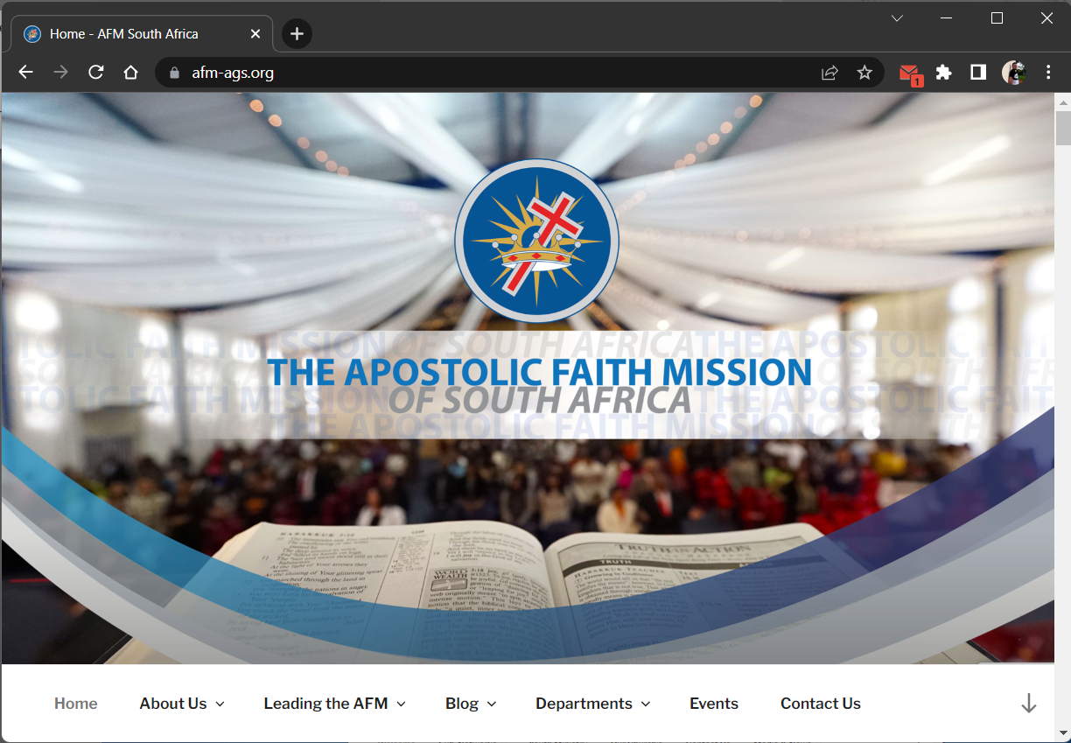
National Website
Notes:
Notes Notes Notes Notes Notes Notes Notes Notes Notes Notes
Notes Notes Notes Notes Notes Notes Notes Notes Notes Notes
Notes Notes Notes Notes Notes Notes Notes Notes Notes Notes

Slide 3
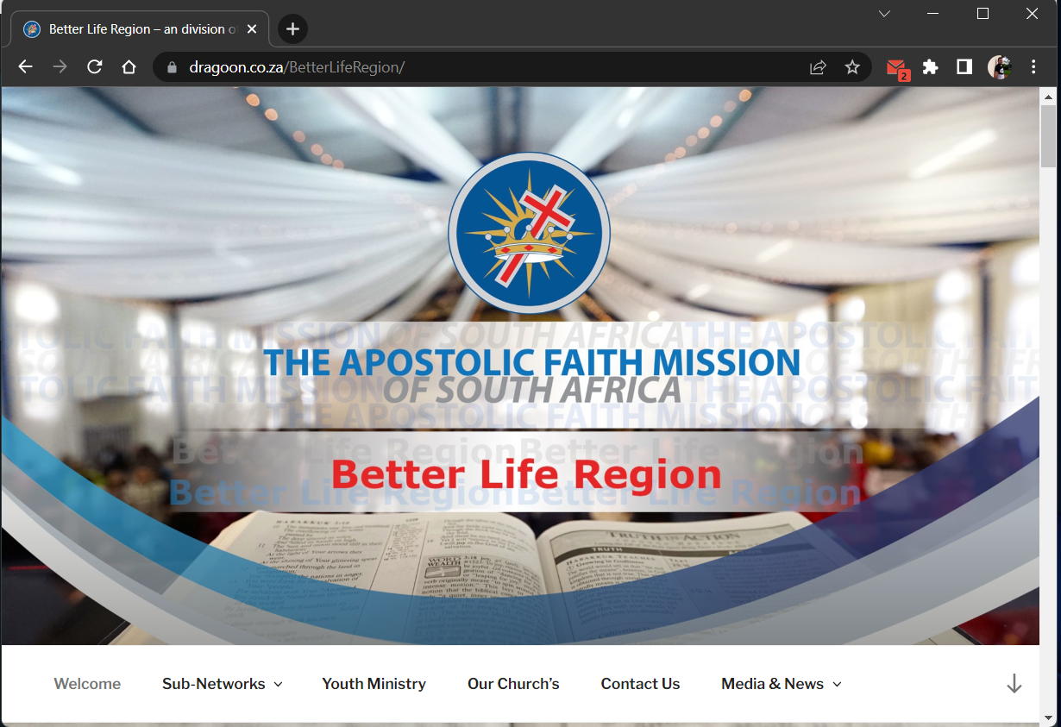
Region Website
Notes:
Notes Notes Notes Notes Notes Notes Notes Notes Notes Notes
Notes Notes Notes Notes Notes Notes Notes Notes Notes Notes
Notes Notes Notes Notes Notes Notes Notes Notes Notes Notes

Slide 4




Region Website - Responsive
Notes:
Notes Notes Notes Notes Notes Notes Notes Notes Notes Notes
Notes Notes Notes Notes Notes Notes Notes Notes Notes Notes
Notes Notes Notes Notes Notes Notes Notes Notes Notes Notes

Slide 5
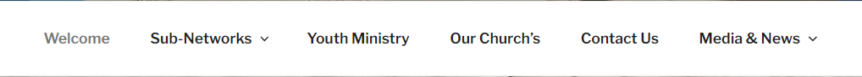

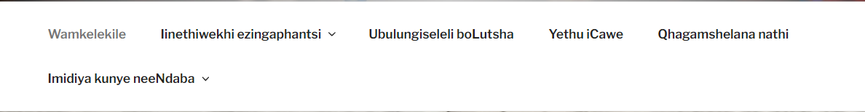
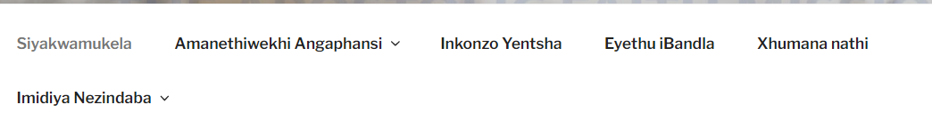
Region Website – Languages: English, Afrikaans ,Sesotho ,Xhosa ,Zulu
Notes:
Notes Notes Notes Notes Notes Notes Notes Notes Notes Notes
Notes Notes Notes Notes Notes Notes Notes Notes Notes Notes
Notes Notes Notes Notes Notes Notes Notes Notes Notes Notes

Slide 6
Region Website
CMS (Content Management System) - implemented
Look and feel – implemented
Colour: consistent with National - implemented
Imagery & banners: consistent design inspired National - implemented
Navigation – implemented
Responsive Device PC, Tablet, Cell – implemented
Populate Church and Pastor Content – Requested (May) Cut off (Close of business 5pm - 20 June 2022)
Notes:
Notes Notes Notes Notes Notes Notes Notes Notes Notes Notes
Notes Notes Notes Notes Notes Notes Notes Notes Notes Notes
Notes Notes Notes Notes Notes Notes Notes Notes Notes Notes

Slide 7
Request for Data - Committee
Good photos of Office Bearer/Subnetleader
Short Biography of Office Bearer/Subnetleader
Short introductory video of member
Name of Office (Subnetwork name/Office held)
Short description of Subnetwork
Contact details
Assemblies in Subnetwork
Location of Assemblies
Pastors of assemblies
Photos of pastors in assemblies
Short introductory video of pastor
Photos of assemblies
Contact details assemblies

Slide 8
Request for Data - Ministries
Good photos of Ministry Leader
Vision and Mission of Ministry
Ministry regional committee
Good photos of committee members
Ministry contact details
Ministry year program
Events
Contact details

Slide 9
Request for Data - Assemblies
Good photos of pastor
Photos of assembly
Short description of assembly
Location of assembly
Contact details

